Slide 2
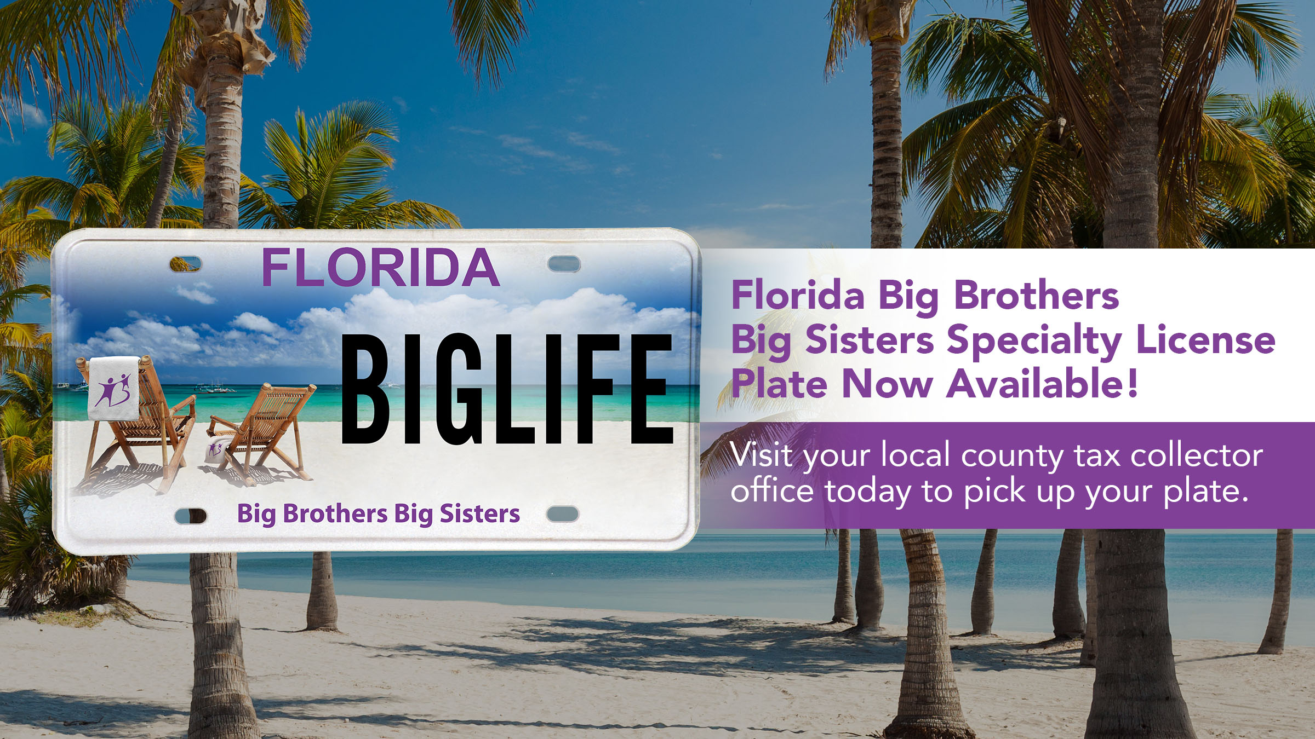
Or visit www.bbbstampabay.org/plate to learn more!

